Slide 1
Open House and Information Night

Slide 2
Agenda
Franklin Center Overview
  Executive Director
Presentations
  Admissions Director
  Academy Principal
  Enrichment Program Manager
  Therapy Services Director
  Capstone (Adult Education) Director
Q&A - Capstone Parents move to Community Room
Group Tours and/or Meeting with Staff and Parents

Slide 3
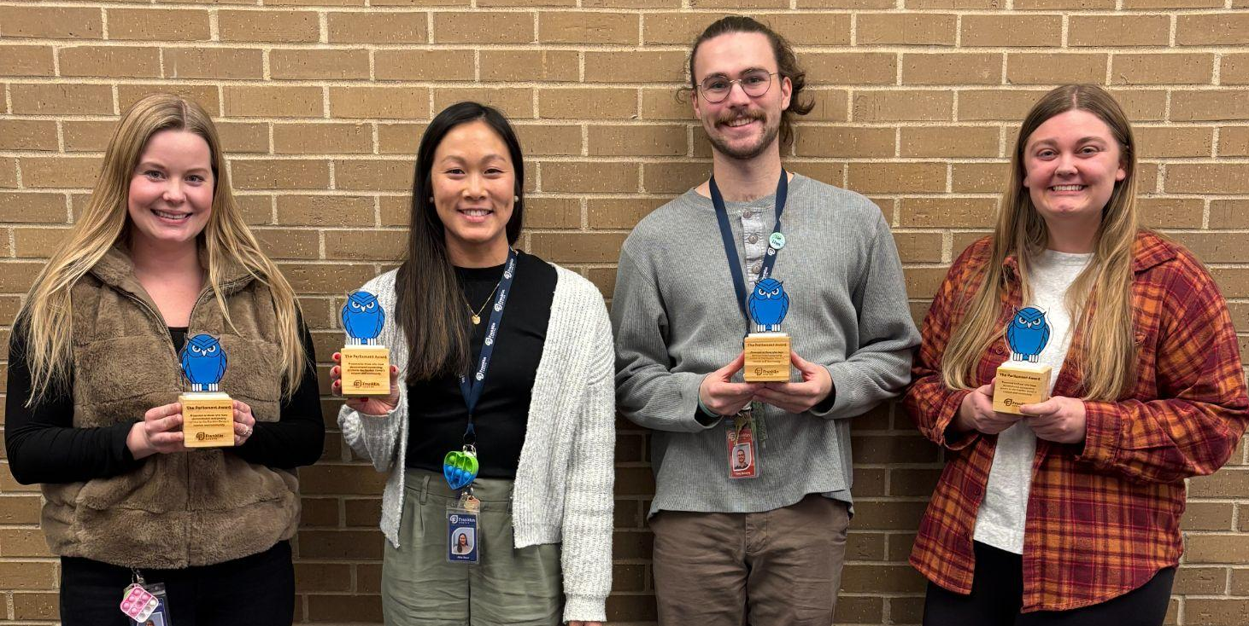
Franklin Center Overview
Kim Snow
Executive Director

Slide 4

Mission
We transform lives by addressing the holistic academic, social, emotional and mental health needs of the neurodiverse community.
Vision
Enable our neurodiverse community to have an exceptional human experience.

Slide 5
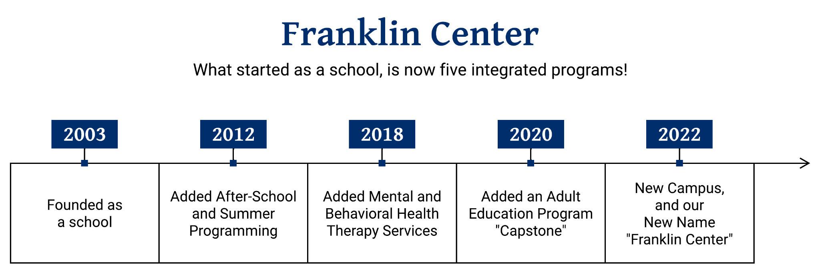
History

Slide 6






A Minnesota school unlike any other, delivering K-12 education through personalized accommodations for neurodiverse students.
Fully licensed, comprehensive therapy for the neurodiverse, with a focus on the intersection of behavioral and mental health.
Engaging experiences outside of school where students build friendships, create connections, and develop social skills.
Calm summer camps for neurodiverse or sensory sensitive students to maintain their learning, have fun, and make friends.
A post-secondary program offering a full range of life skills courses, preparing neurodiverse young adults to live independently with confidence.

Slide 7
Who we uniquely serve and how…
We best serve people, ages 4-28, with neurodiversities who struggle in traditional settings because of their challenges with mental health, behavioral regulation, executive functioning and/or social skills. We meet them where they are and help them gain skills to become confident and healthy members of society through integrated, credentialed programming at a single location.

Slide 8
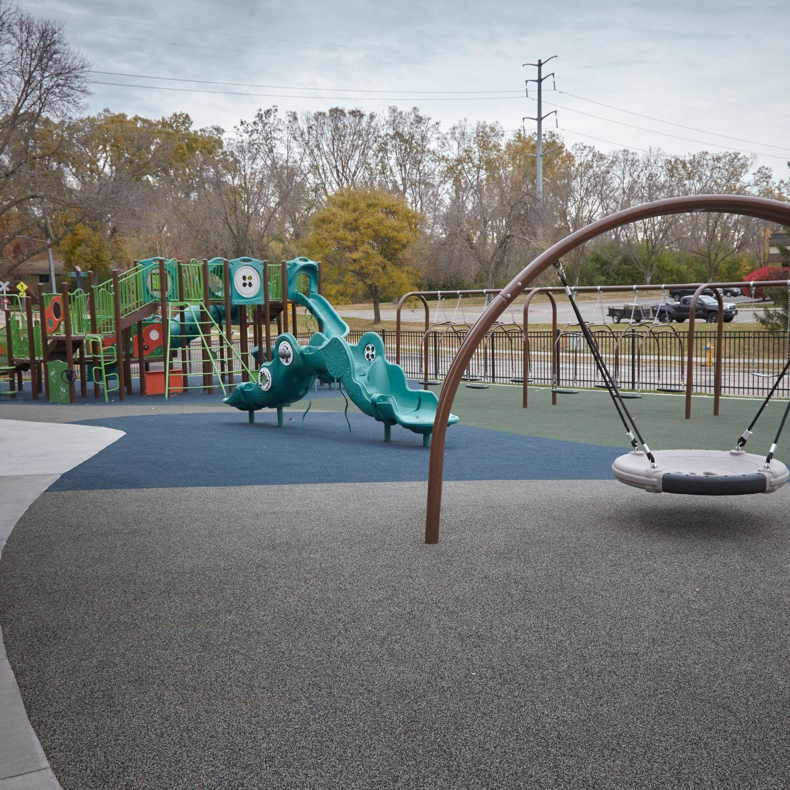
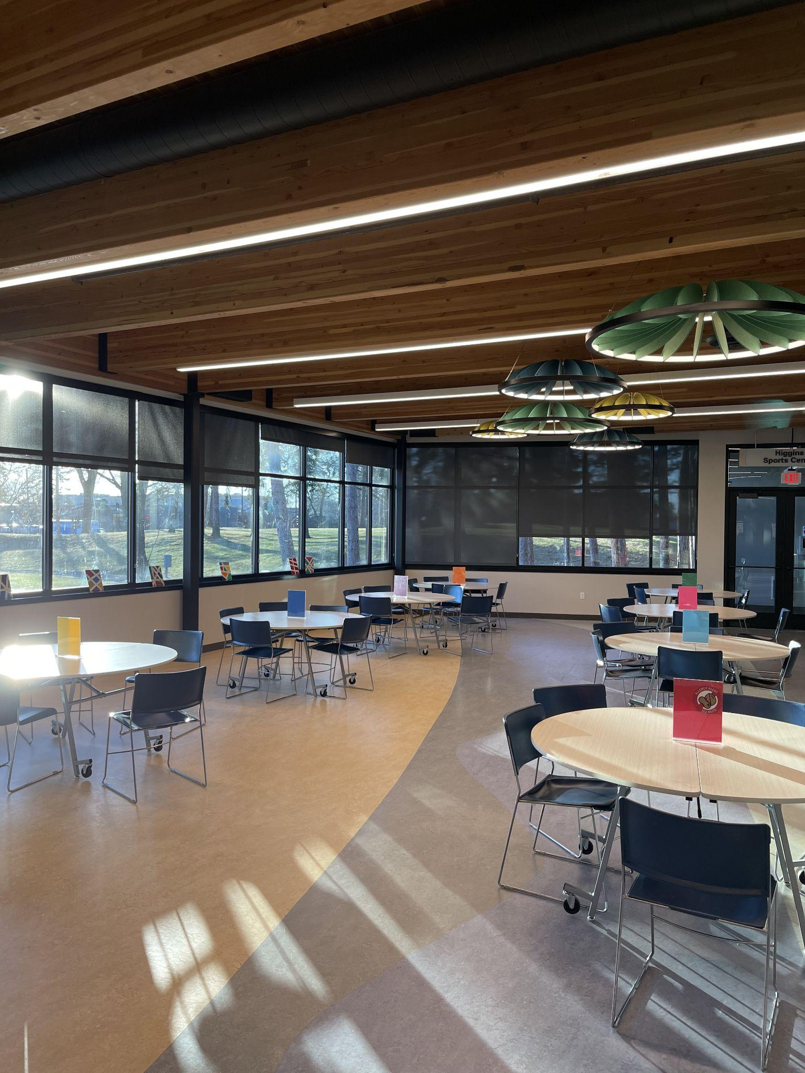
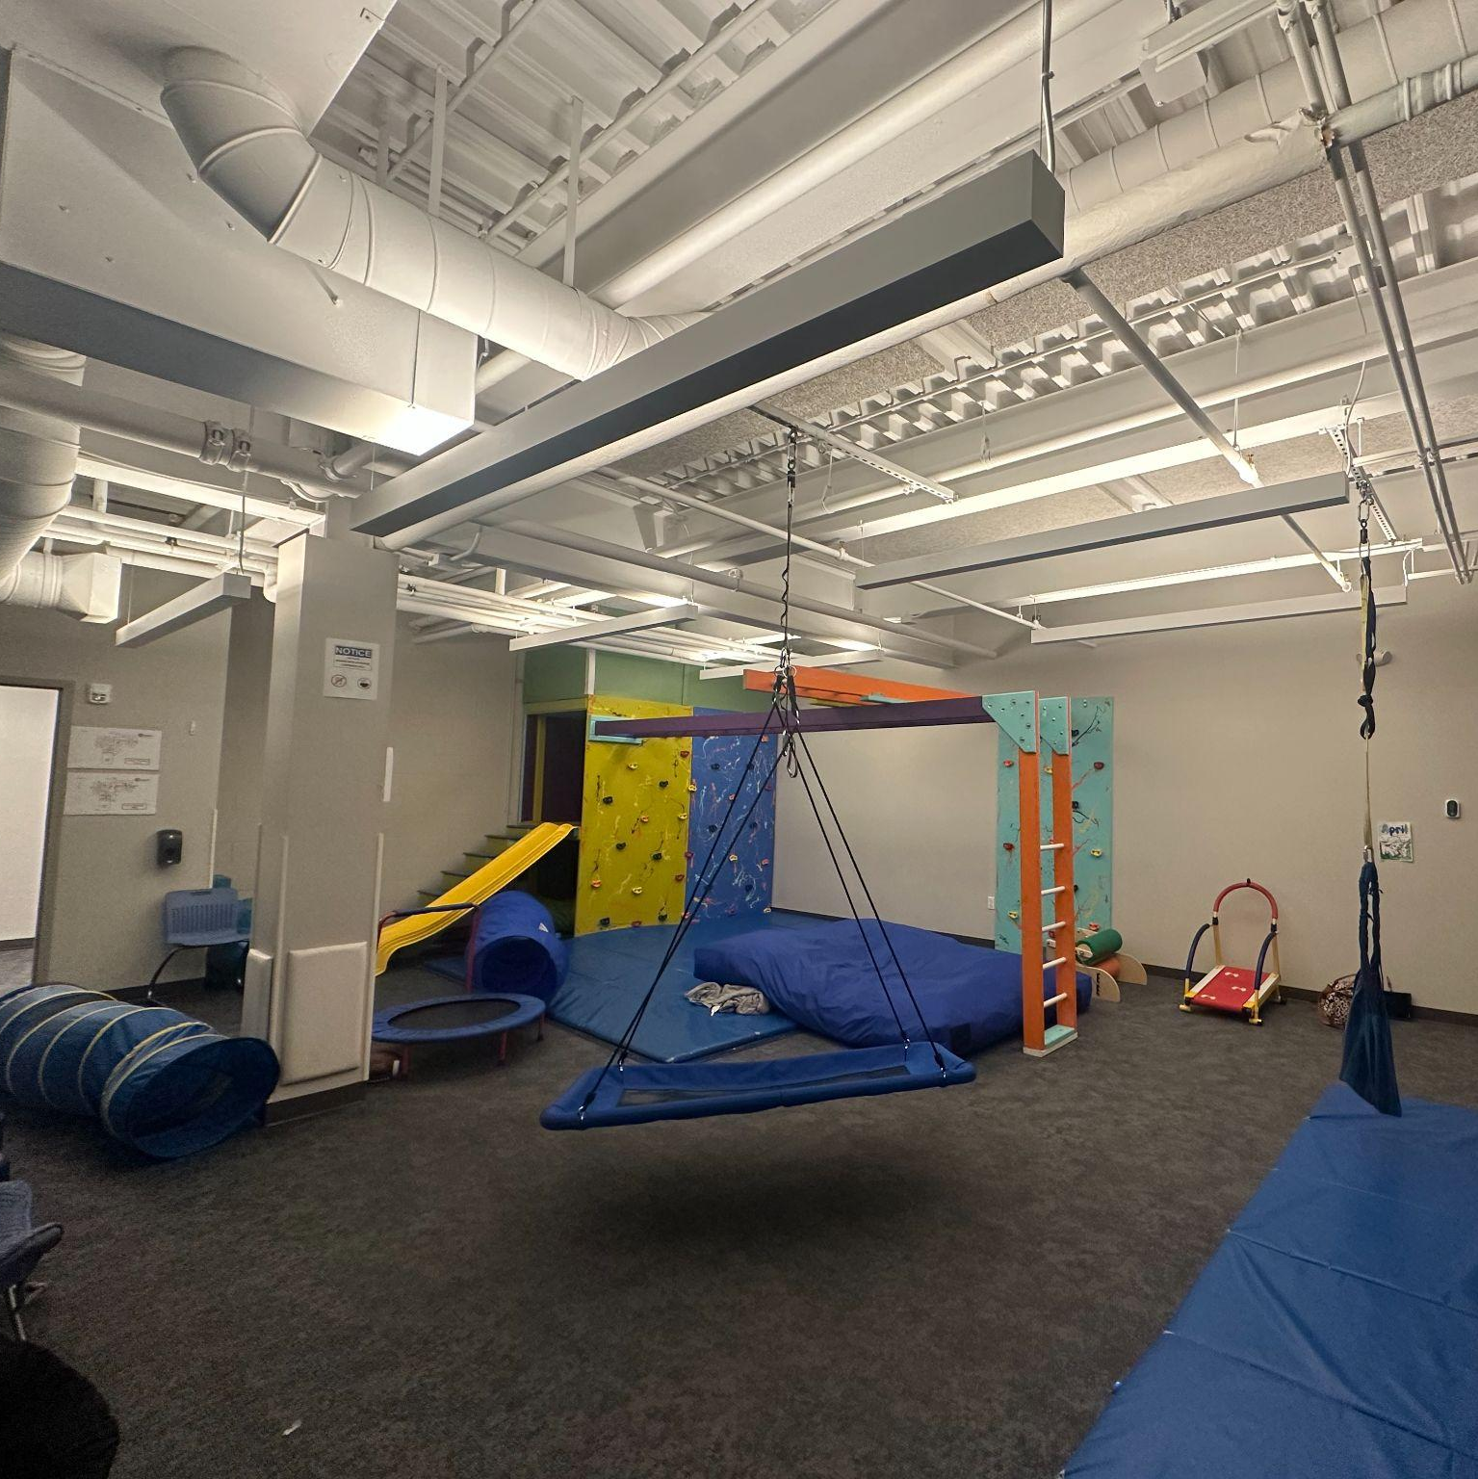
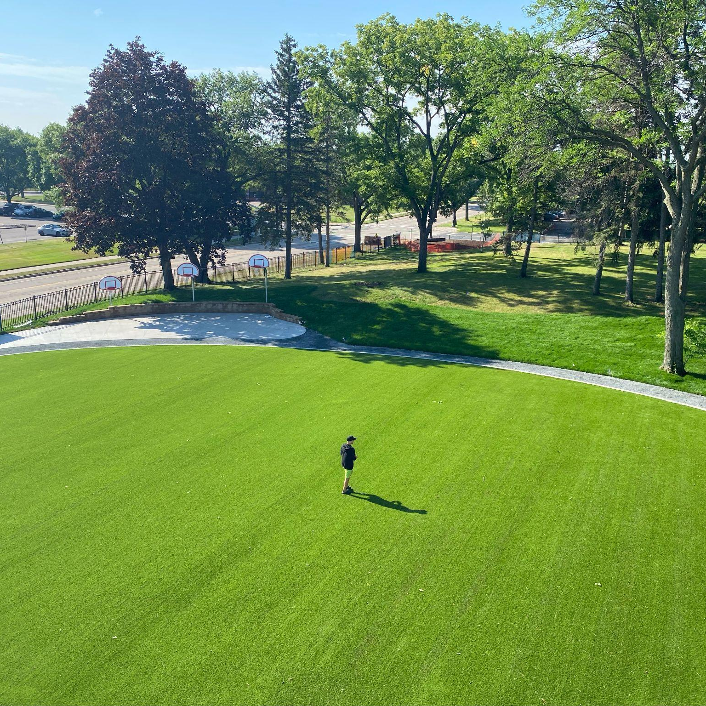
State of the Art Facilities
Over five acres of land with 50,000 square feet of facilities with an environmentally & inclusively conscious design.
Sensory friendly lighting, lockers, flexible furniture for learning, bridge/break space in all classrooms.
Sound sensitive fully adapted Gym, Science Lab, Learning Kitchen & dedicated Art space.

Slide 9
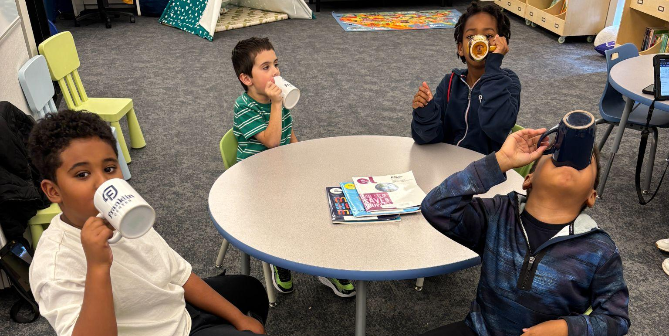
Paul Gloudemans
Admissions Director

Slide 10
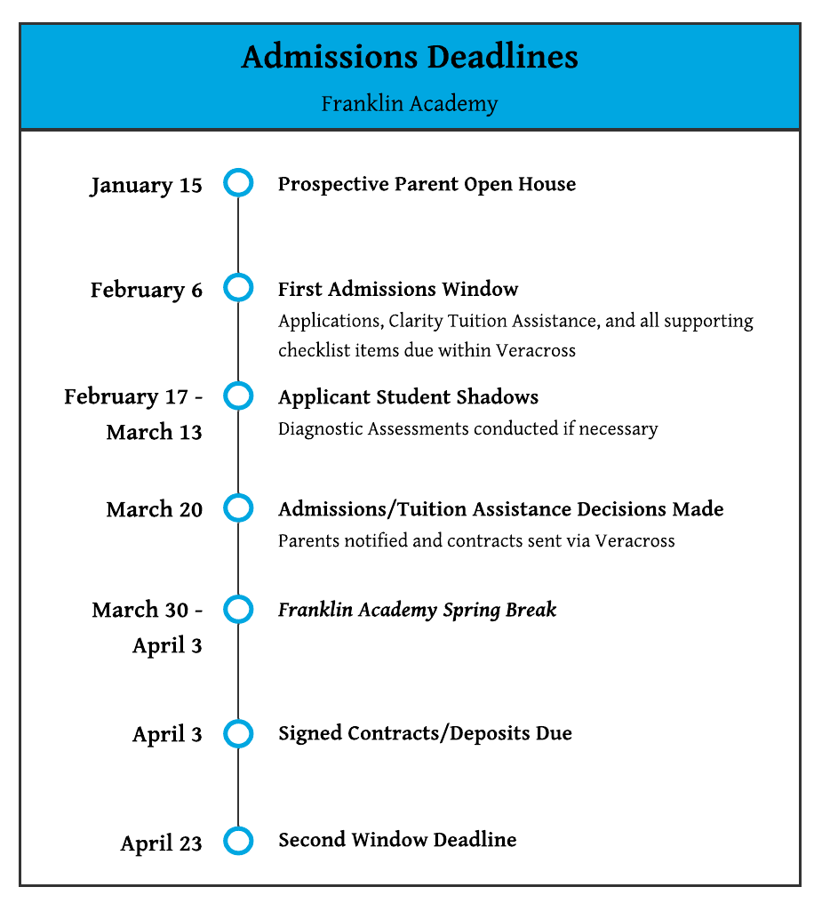

Slide 11
2025-26 Academic Year Tuition & Fees
ALL GRADES K-12: $38,000
(Updated Tuition for 2026-27 will be determined in early Feb)
Tuition includes all textbooks and school supplies. It does not include before or after school care, co-curricular activities, transportation or lunch.
Financial Aid: Application through Clarity
Crosby Scholarship
https://franklinmn.org/academy/tuition-assistance/

Slide 12
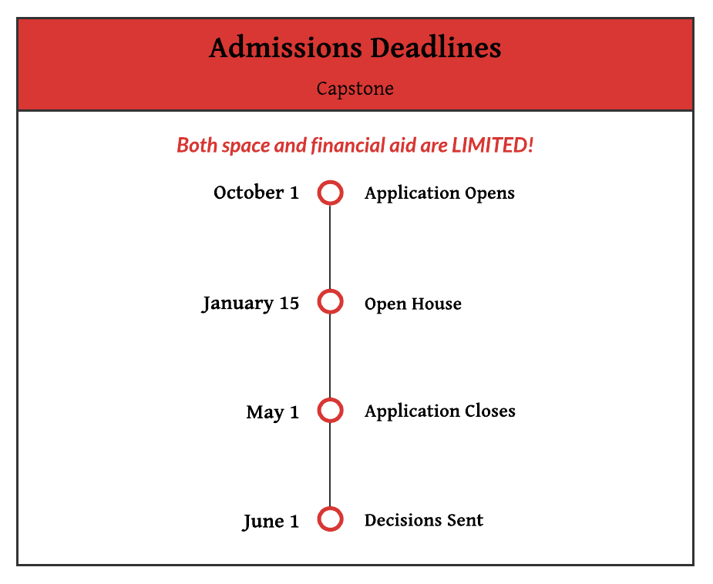
October 1
January 15
May 1
June 1

Slide 13
2025-26 Capstone Full Year Tuition & Fees
Full Day
  (30 hours a week, M-TH) → $36,800
Flex Day
  (20 hours a week, M-TH) → $26,000
College Flex Day
  (8 hours a week, M,W) → $12,000
Community Engagement Days (All-Day, 10:00am - 3:00pm, Fridays*)
  $3,000 = (19 days, 2 overnights)
  $5,900 = all-year (43 days, 2 overnights)
*Prices are doubled for non-participants
Many families are able to utilize County Waivers to pay for programming,
or can qualify for tuition assistance through Franklin Center.

Slide 14
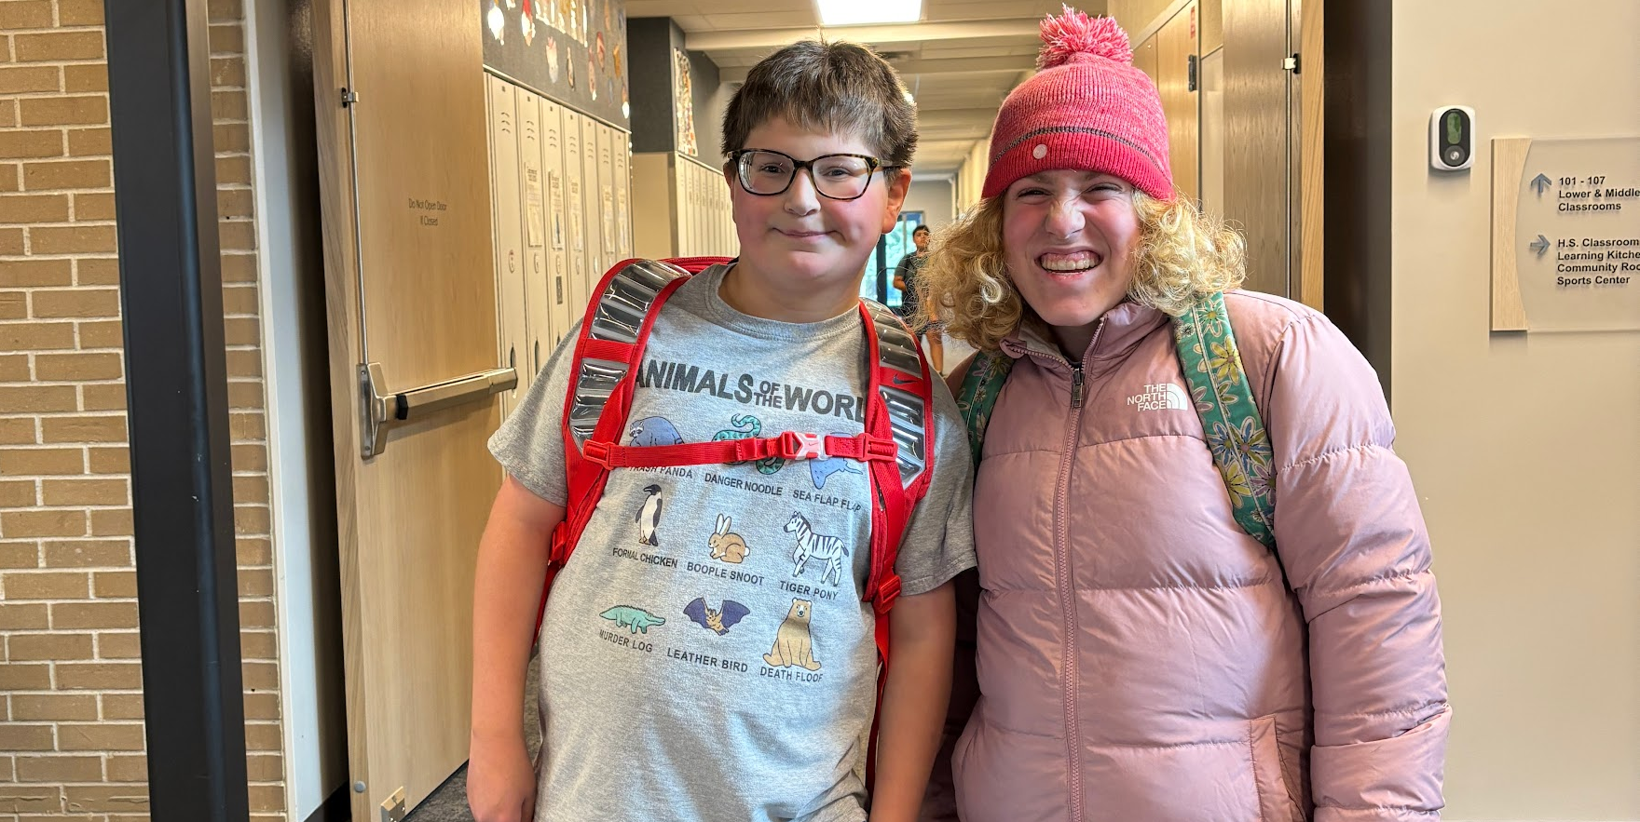
Kim Strandemo
Academy Principal

Slide 15
Franklin’s Approach to Learning
Support Whole Child:
Understood
Supported
Challenged
Celebrated
Classrooms built on:
Relationships
Individualized learning
Collaboration with families
Evidenced Based learning
Consistency and Safety

Slide 16
Pillars of our Academy
Academic Learning
Social/Behavioral Learning
Parent Communication
“Meet Students where they are”
How we assess learning
Differentiate
Support progress
Communicate growth
“Holistic Approach”
Build community
Support emotional needs
Manage behavior consistently
Partner with our support teams
“Share their Student”
Weekly highlights
Monthly/Bi-Monthly reports
Conferences
Real-time communication when needed

Slide 17
Qualified, Caring and Dedicated Staff
90% of our staff returned this year, providing continuity, strong relationships, and a stable learning environment for students.
Teachers not only teach our Mission, Vision and Values, they model them every day.
Educators certified in both General Education and/or Special Education.
Accredited School of Excellence.
Successfully educated over 300 students!
Notes:
National Association of Special Education Teachers

Slide 18
Holistic Educational Experience
Unlock
  Identify student needs and strengths in both Academics and Social Emotional Learning.
Empower
  Balanced approach of Academics, Social Emotional and Life Skills to develop personalized goals and accommodations.
Soar
  Foster a holistic approach to learning by promoting self discovery, self awareness and self regulation.
Notes:
Unlock - academics = continuums
social emotional = assessment of functional living skills (afls) Therapy collaboration/on site
At Franklin Academy, we focus on the whole child—academically, socially, and emotionally—so every student can thrive.

Slide 19
Unique Model
Student Centered Learning K-12
Comprehensive Student Support
Enriched Learning
Small Class Sizes
Individual Learning Plans
Flexible Pacing
Safe, Supported Environment
Classroom Behavior Support K-12
Mental Health Support
Dedicated Team
Specialist Classes
Electives in the High School
Clubs and Enrichment activities after school and during the summer

Slide 20
Integrated Therapy Support
The Therapy Department is integrated throughout the Academy. Each classroom is supported by a Behavior Therapist who assists with social, emotional, and behavioral learning. This integration serves as a bridge between the Academy and therapeutic services.
If there is more support needed, a recommendation can be made for Clinical Services.

Slide 21
Behavior Team
Behavior Therapist Support
Social/Behavioral Learning
Parent Communication
Support is gradually released across divisions as students build independence
Individualized goals are developed for each student and targeted throughout the school year.
Behavior Therapists lead a social/emotional class
Support students’ emotional needs and collaborate with the outpatient team, as needed.
Conduct Social Pull out groups
Develop proactive plans that support consistency between school and home.
Provide monthly or bi-monthly progress reports.
Participate in scheduled conferences.
Maintain real-time communication as needed.

Slide 22
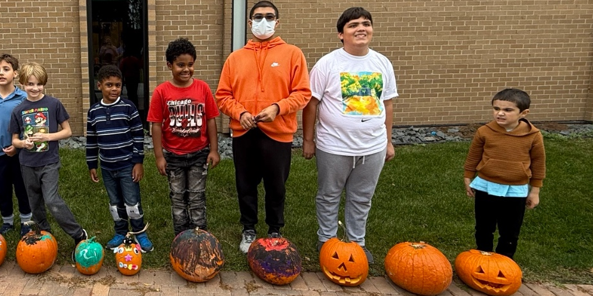
Chloe Herzog
Enrichment Program Manager

Slide 23
Camp Franklin and Enrichment Programs
Opportunities for students to build and practice skills while making connections and enhancing friendships.
After-school and Summer which allows kids to focus on areas of interest and desired skill development. Functional Fun!
Staff and Partnership led
  Staff examples: Dungeons & Dragons, Cooking/Baking, Big City Adventures
  Partner examples: Wilderness Inquiry, MacPhail Center for Music, Nexplore

Slide 24
School Year Enrichment Programs
After School Clubs → 3:30pm - 4:30pm
Three Sessions
Examples
  Sports: Floor Hockey, Soccer
  Arts: Junk Journal, Painting
  Cooking: Around the World, Pickle
Activity Days → 8:00am - 3:00pm
Select Days
  No School
  Spring Break
Examples
  Apple Orchard
  Bowling
  Mini Golf
  Science Museum
Owl’s Nest → 3:30 pm - 5:00 pm
After School Care for K-12
AM: 7:00-8:00 am
PM: 3:30-5:00 pm

Slide 25
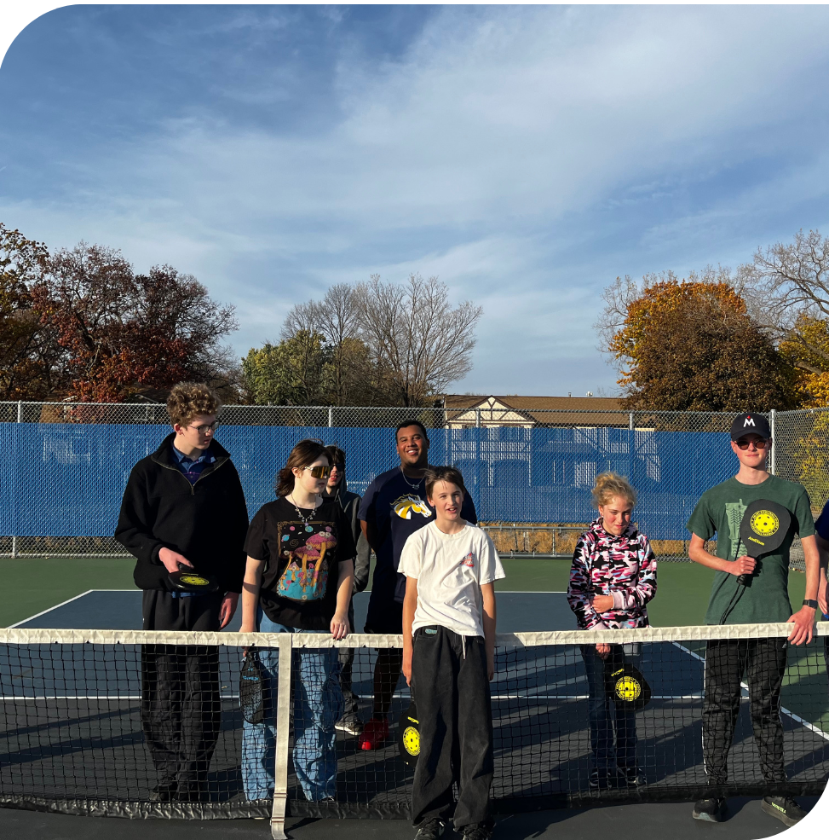
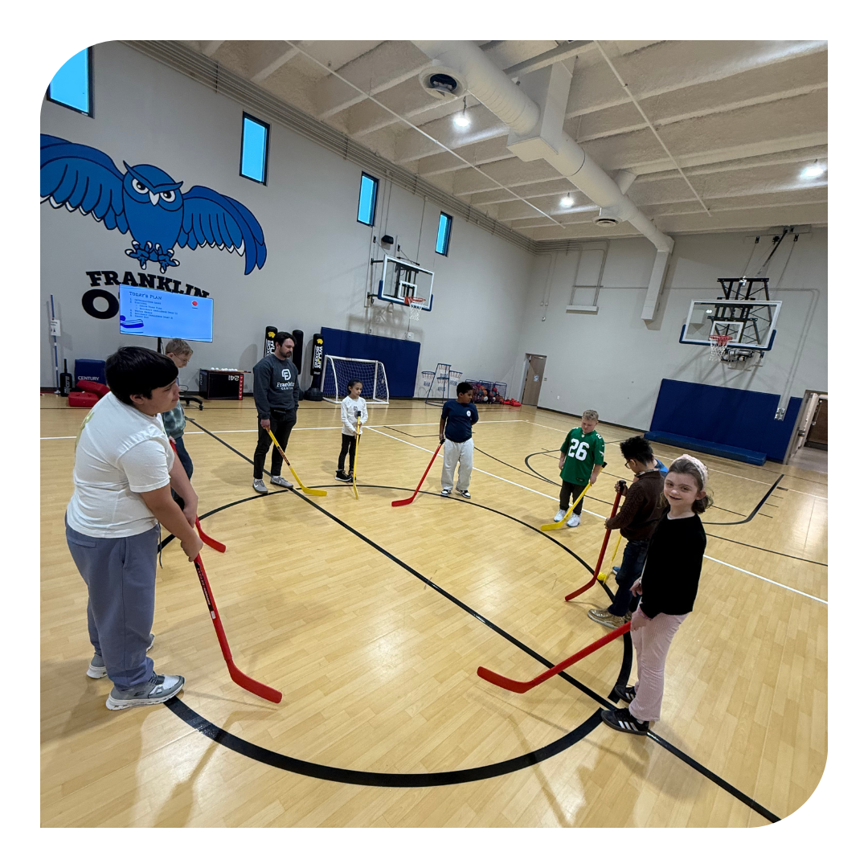
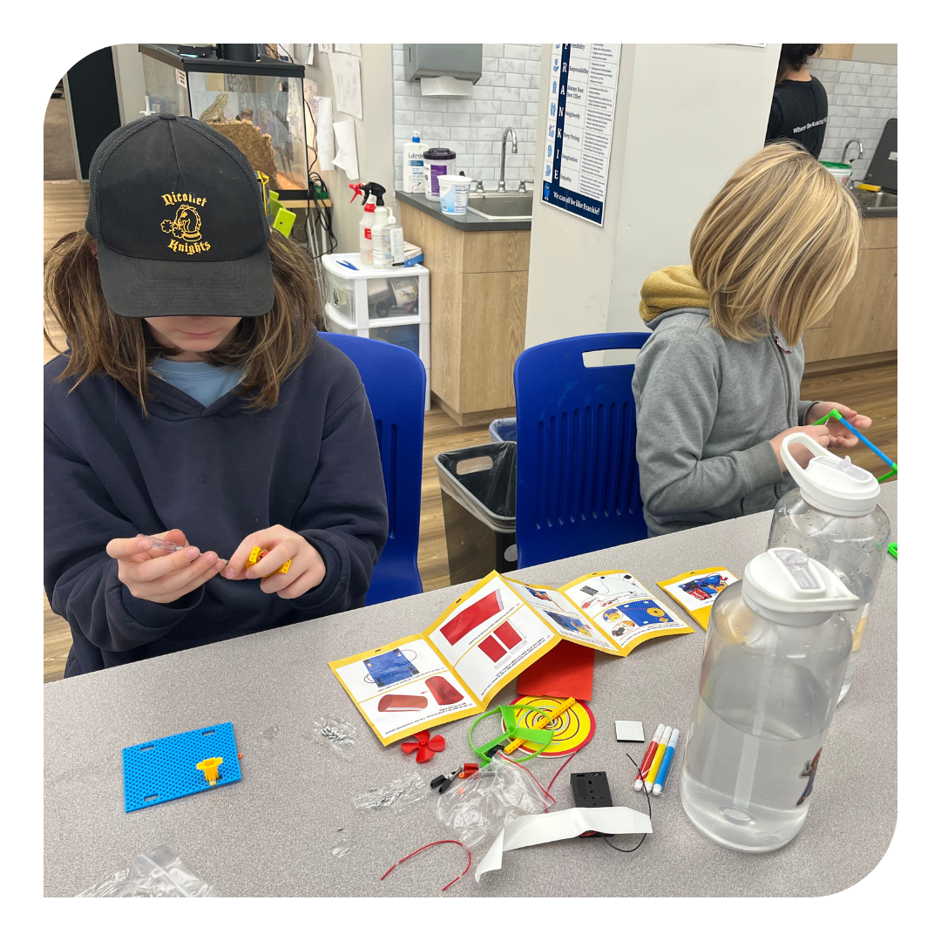

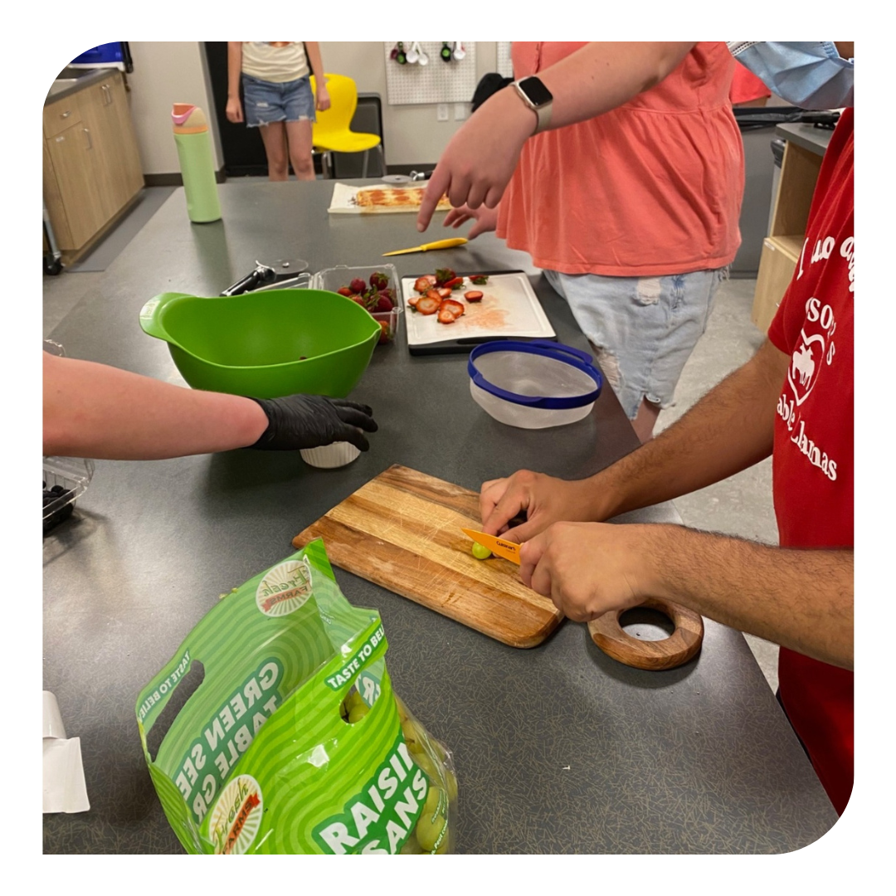
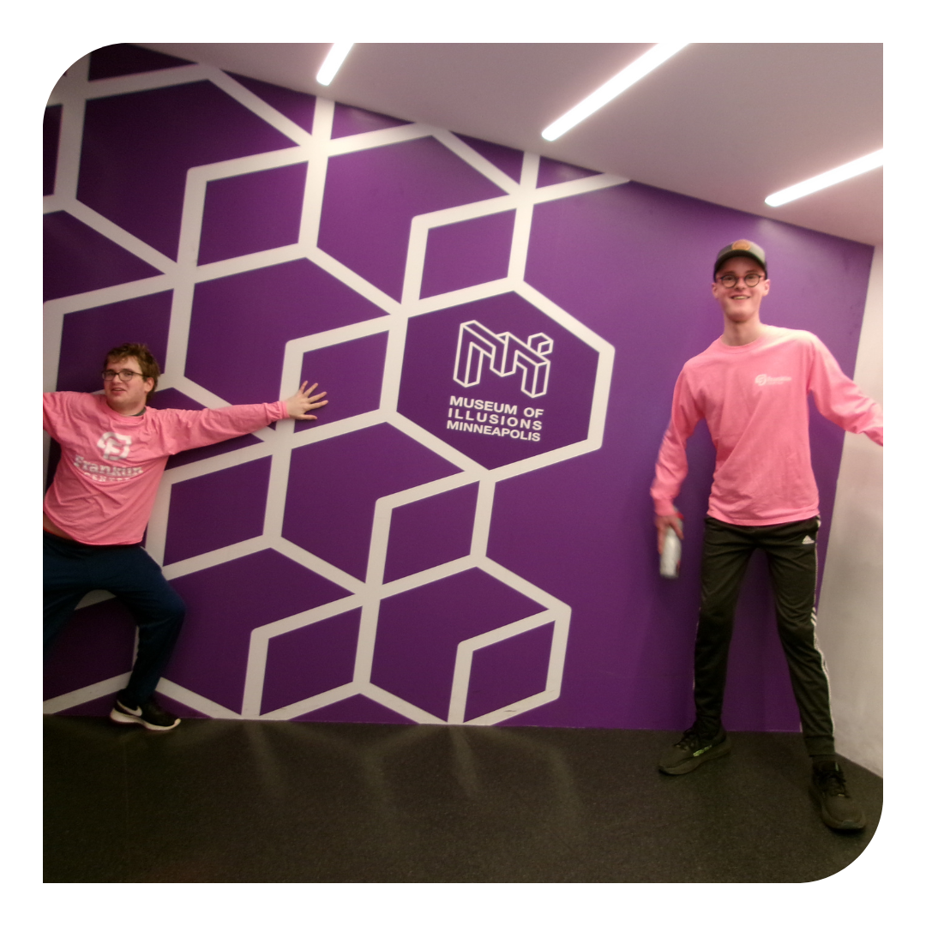
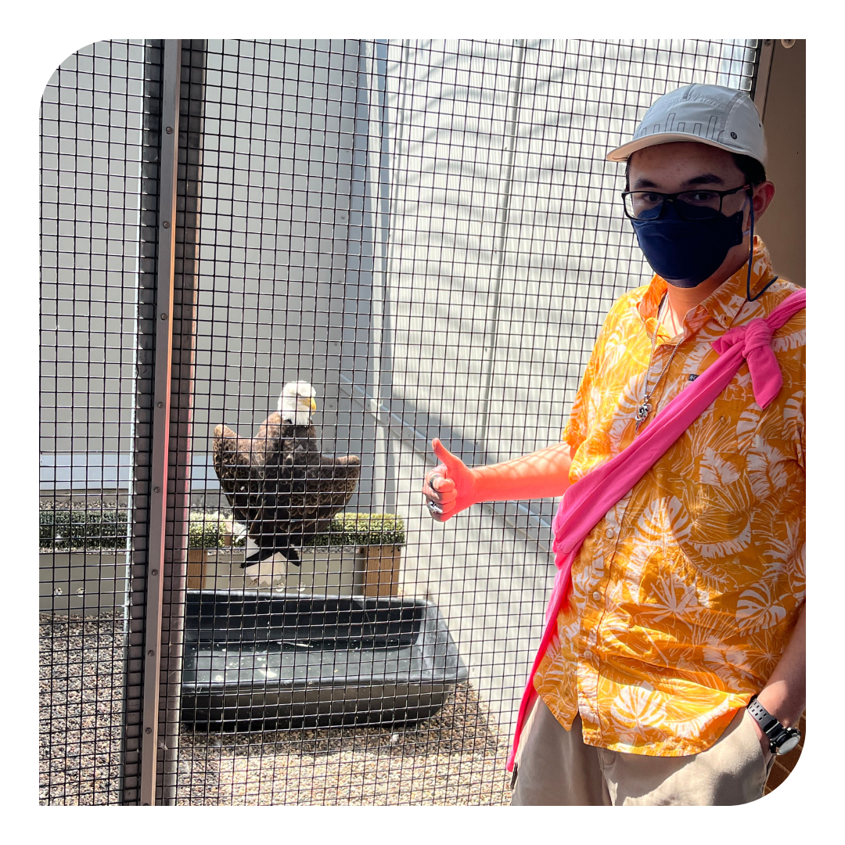
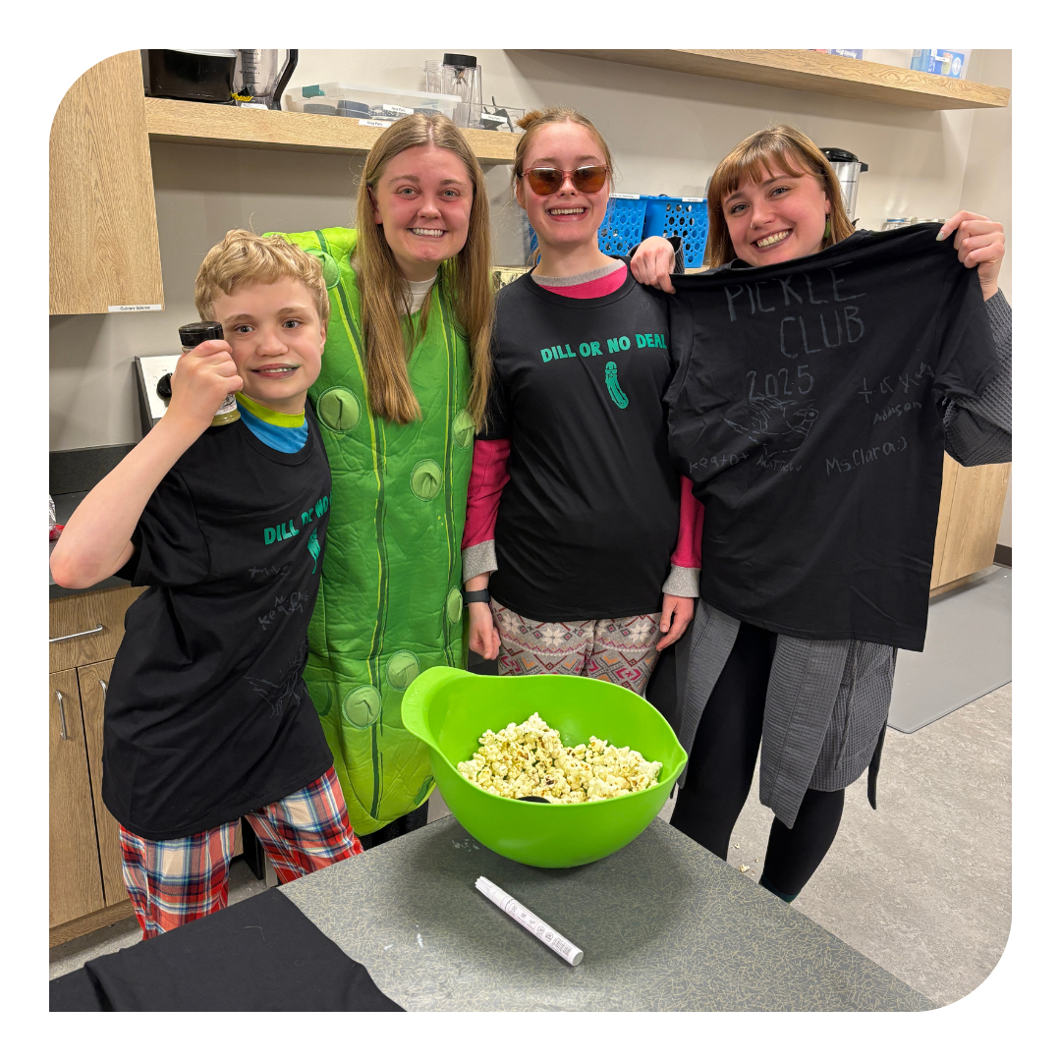

Slide 26
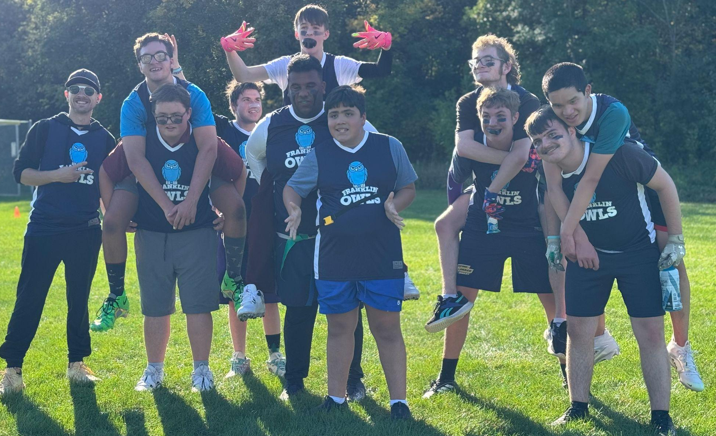
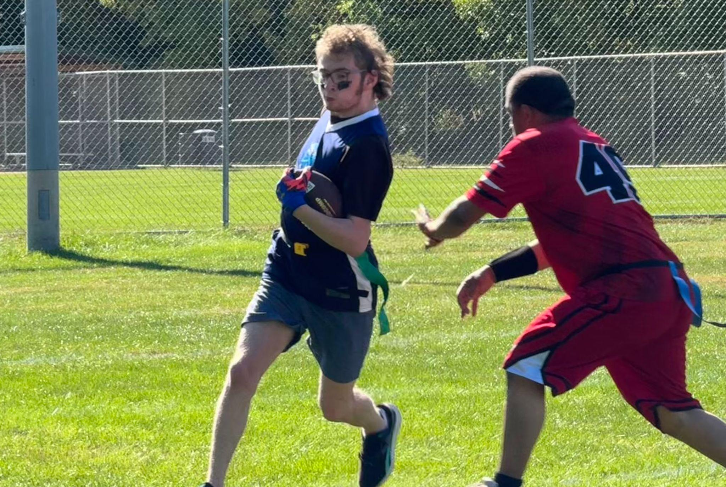
Unified Special Olympics
Flag Football
  August-October
Bowling
  October-November
Basketball
  November- February
Track
  March-April

Slide 27
Camp Franklin
Registration opens for the community on February 2nd.
  Session One: June 8th - 12th
  Session Two: July 6th - 10th
  Session Three: August 3rd - 14th
Summer Activity Days
  June 29th - July 3rd
Owl’s Nest
  AM: 8:00-9:00 am
  PM: 3:00-4:30 pm
To move forward with the registration process, please provide:
  Your child(ren)’s most recent IEP
  School Comprehensive Evaluation, or
  Independent Neuropsych Evaluation from a clinic
Notes:
Add Owl’s Nest

Slide 28


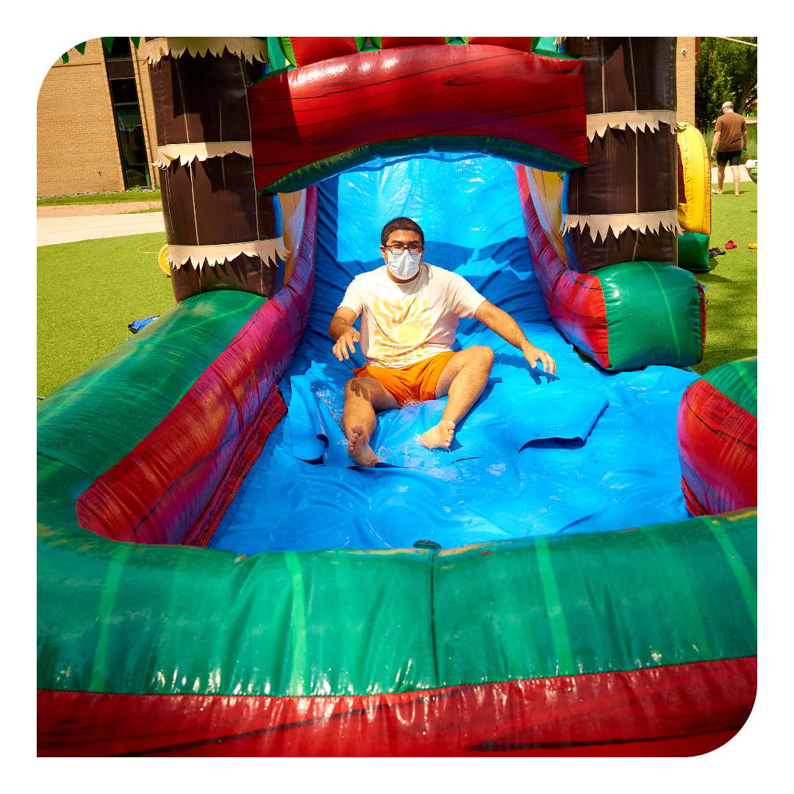

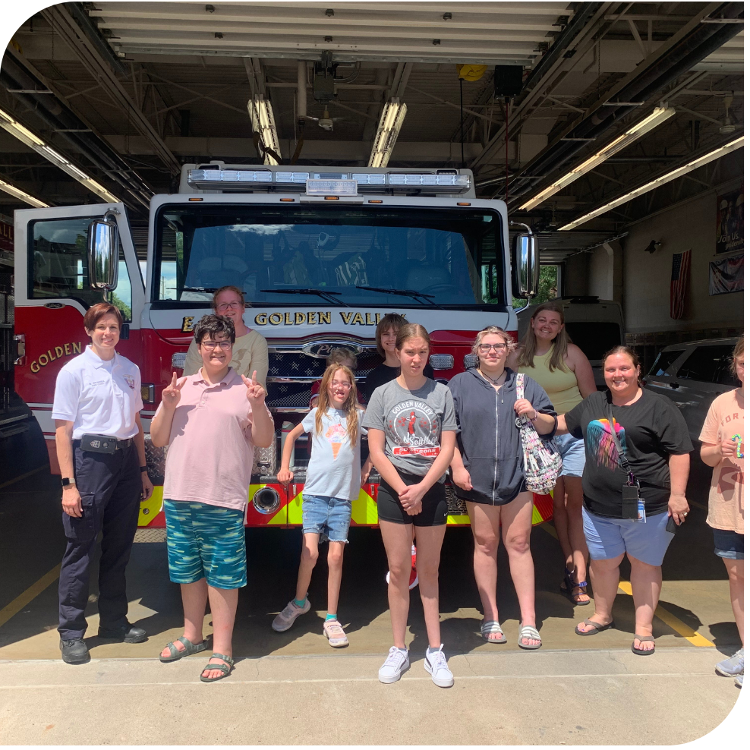
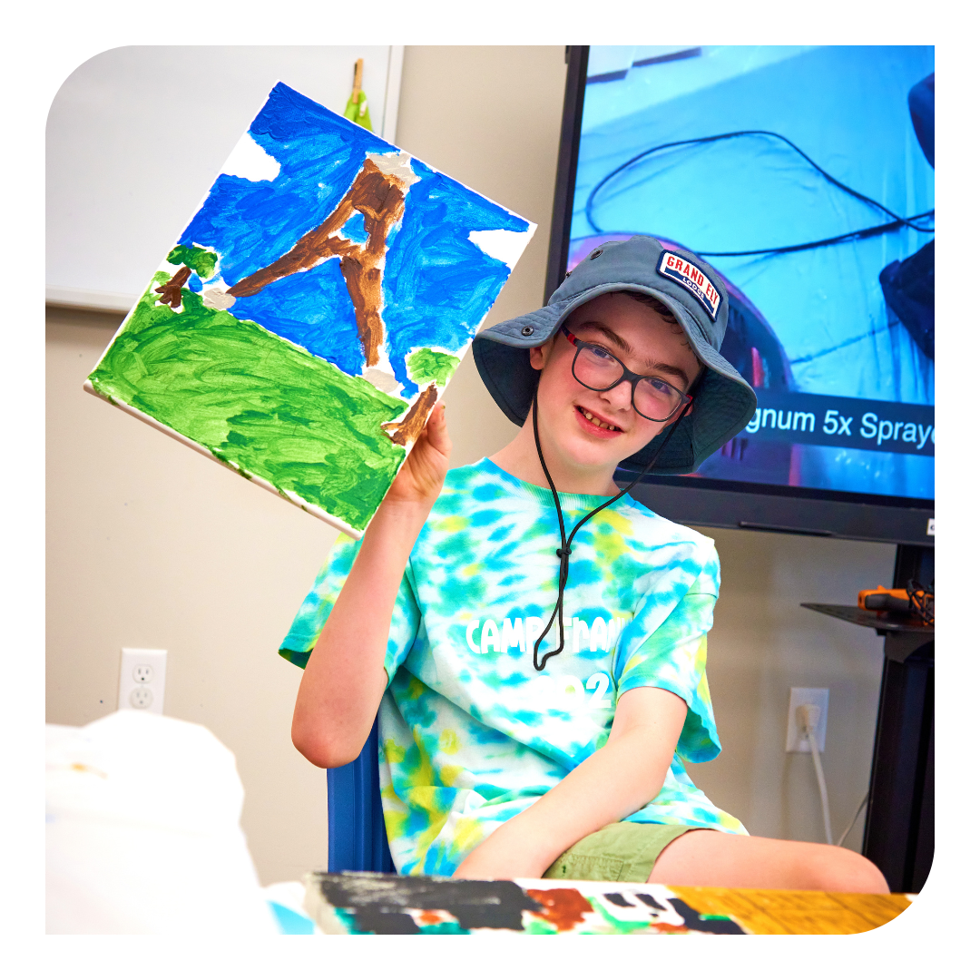

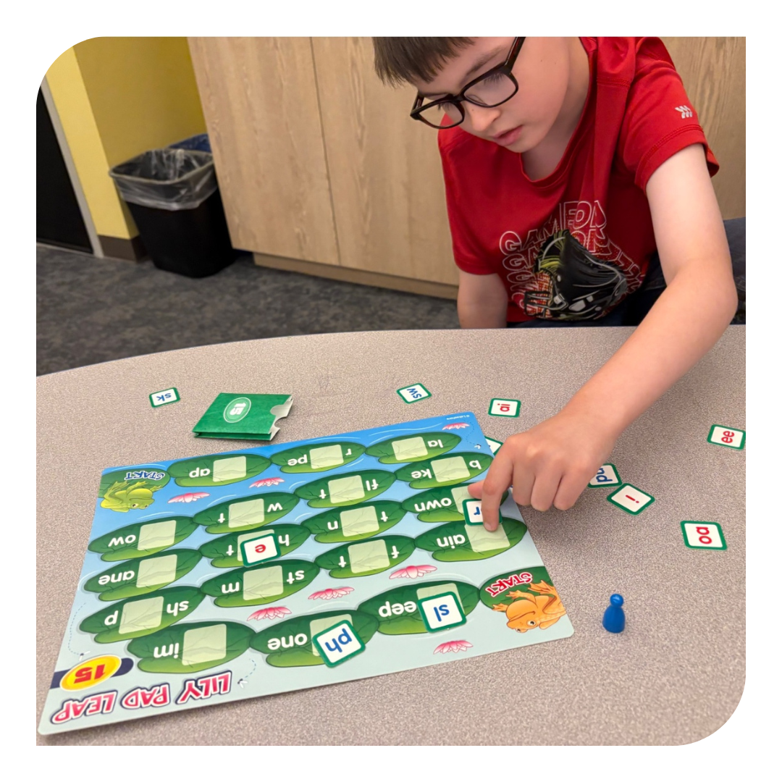

Slide 29
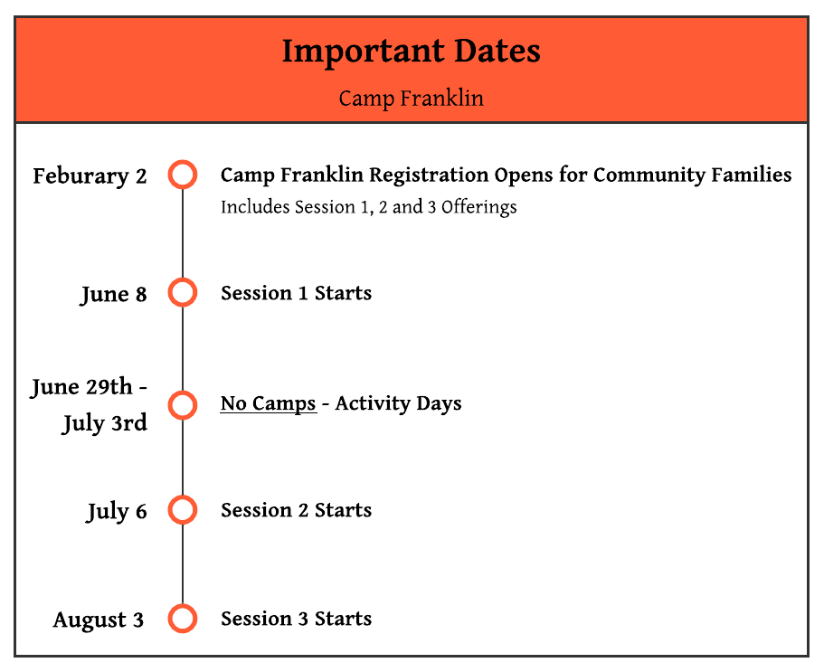

Slide 30


Slide 31
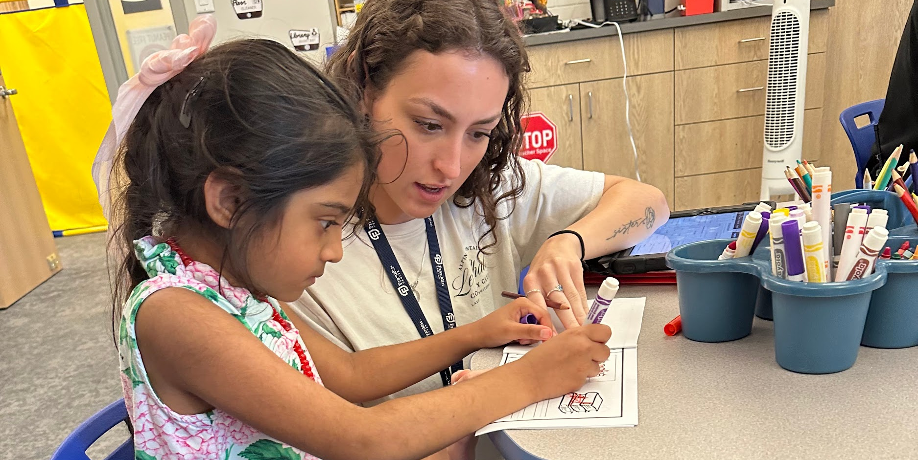
Katie Thormodsgaard
Therapy Services Director

Slide 32
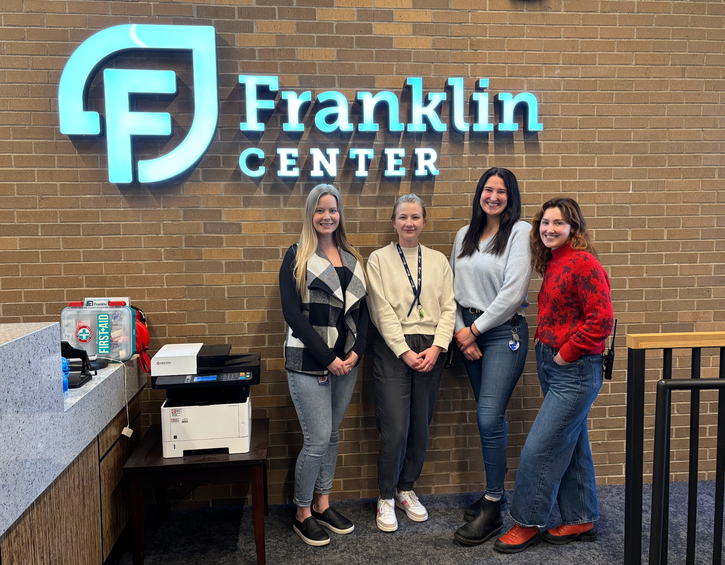
Therapy Services
We are a Fully Licensed, Comprehensive Therapy.
We have Outpatient Therapy, Intensive Behavior Intervention Services, and Family Consultation. We integrate with the Academy by offering service in and out of the classroom.

Slide 33
Program Overview
Outpatient Services
Intensive Behavior Intervention
Family Consultation
Therapy can include one-on-one sessions, and parent support.
Provides mental health support to help clients feel more balanced, confident, and supported in daily life.
Services can be done during the school day or outside of school hours
Provides medically necessary intensive training that targets strengthening functional skills and addressing core deficits
Requires family participation
Offered part time (20 hrs) or full time (40 hrs)
Can be offered in home
Focuses on teaching families effective strategies to support their child’s skill development and promote optimal growth.
Combines individual skill-building with family skill development.
Typically provided in the home or community.
Usually 10 hours per week or less.

Slide 34
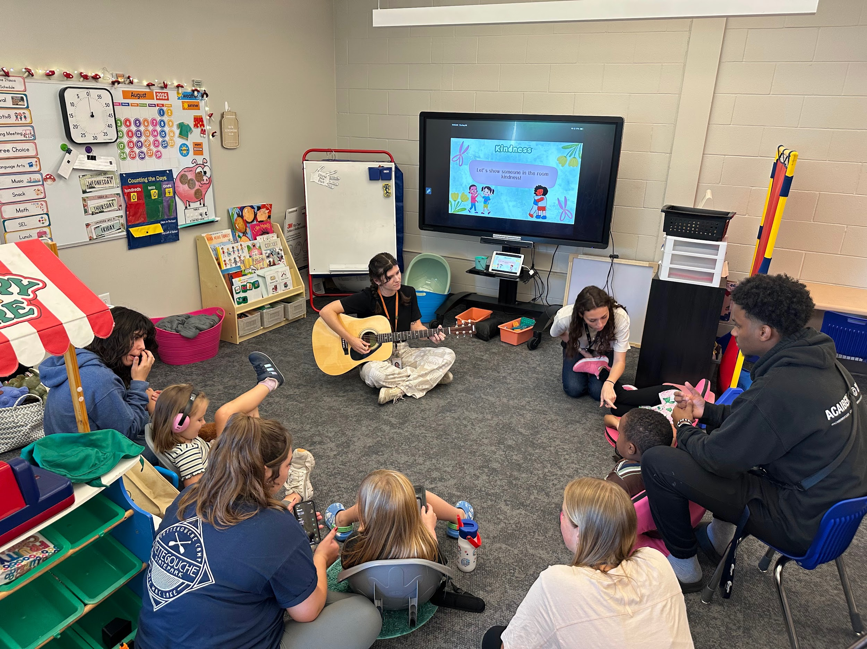
Itasca Therapy Classroom
Itasca is a therapeutic, transitional classroom designed to build skills in preparation for an academic setting.
Lead by a fully licensed teacher
Individualized, evidence-based ABA instruction
Academic, social, emotional, and self-regulation
skill development
Focus on independence and confidence for
future learning
Maximum placement of 3 years with pathways
for continued growth

Slide 35
Dual Enrollment Pathway
Therapy Centric
Classroom Centric
Fading
40 hours of intensive therapy per week, designed to gradually fade into the classroom
Therapy delivered in-class or 1:1 outside the classroom
Full-time classroom hours with a therapist present in the classroom
Therapy continues during school breaks as needed
Gradual transition from full-time to part-time therapy, or part-time to limited hours
Therapist supports learning in the classroom or natural environment

Slide 36


Gradual Release Across Divisions
Lower School: 84% of students receive services
Middle School: 72% of students receive services
High School: 65% of students receive services
Capstone: 42% of students receive services

Slide 37
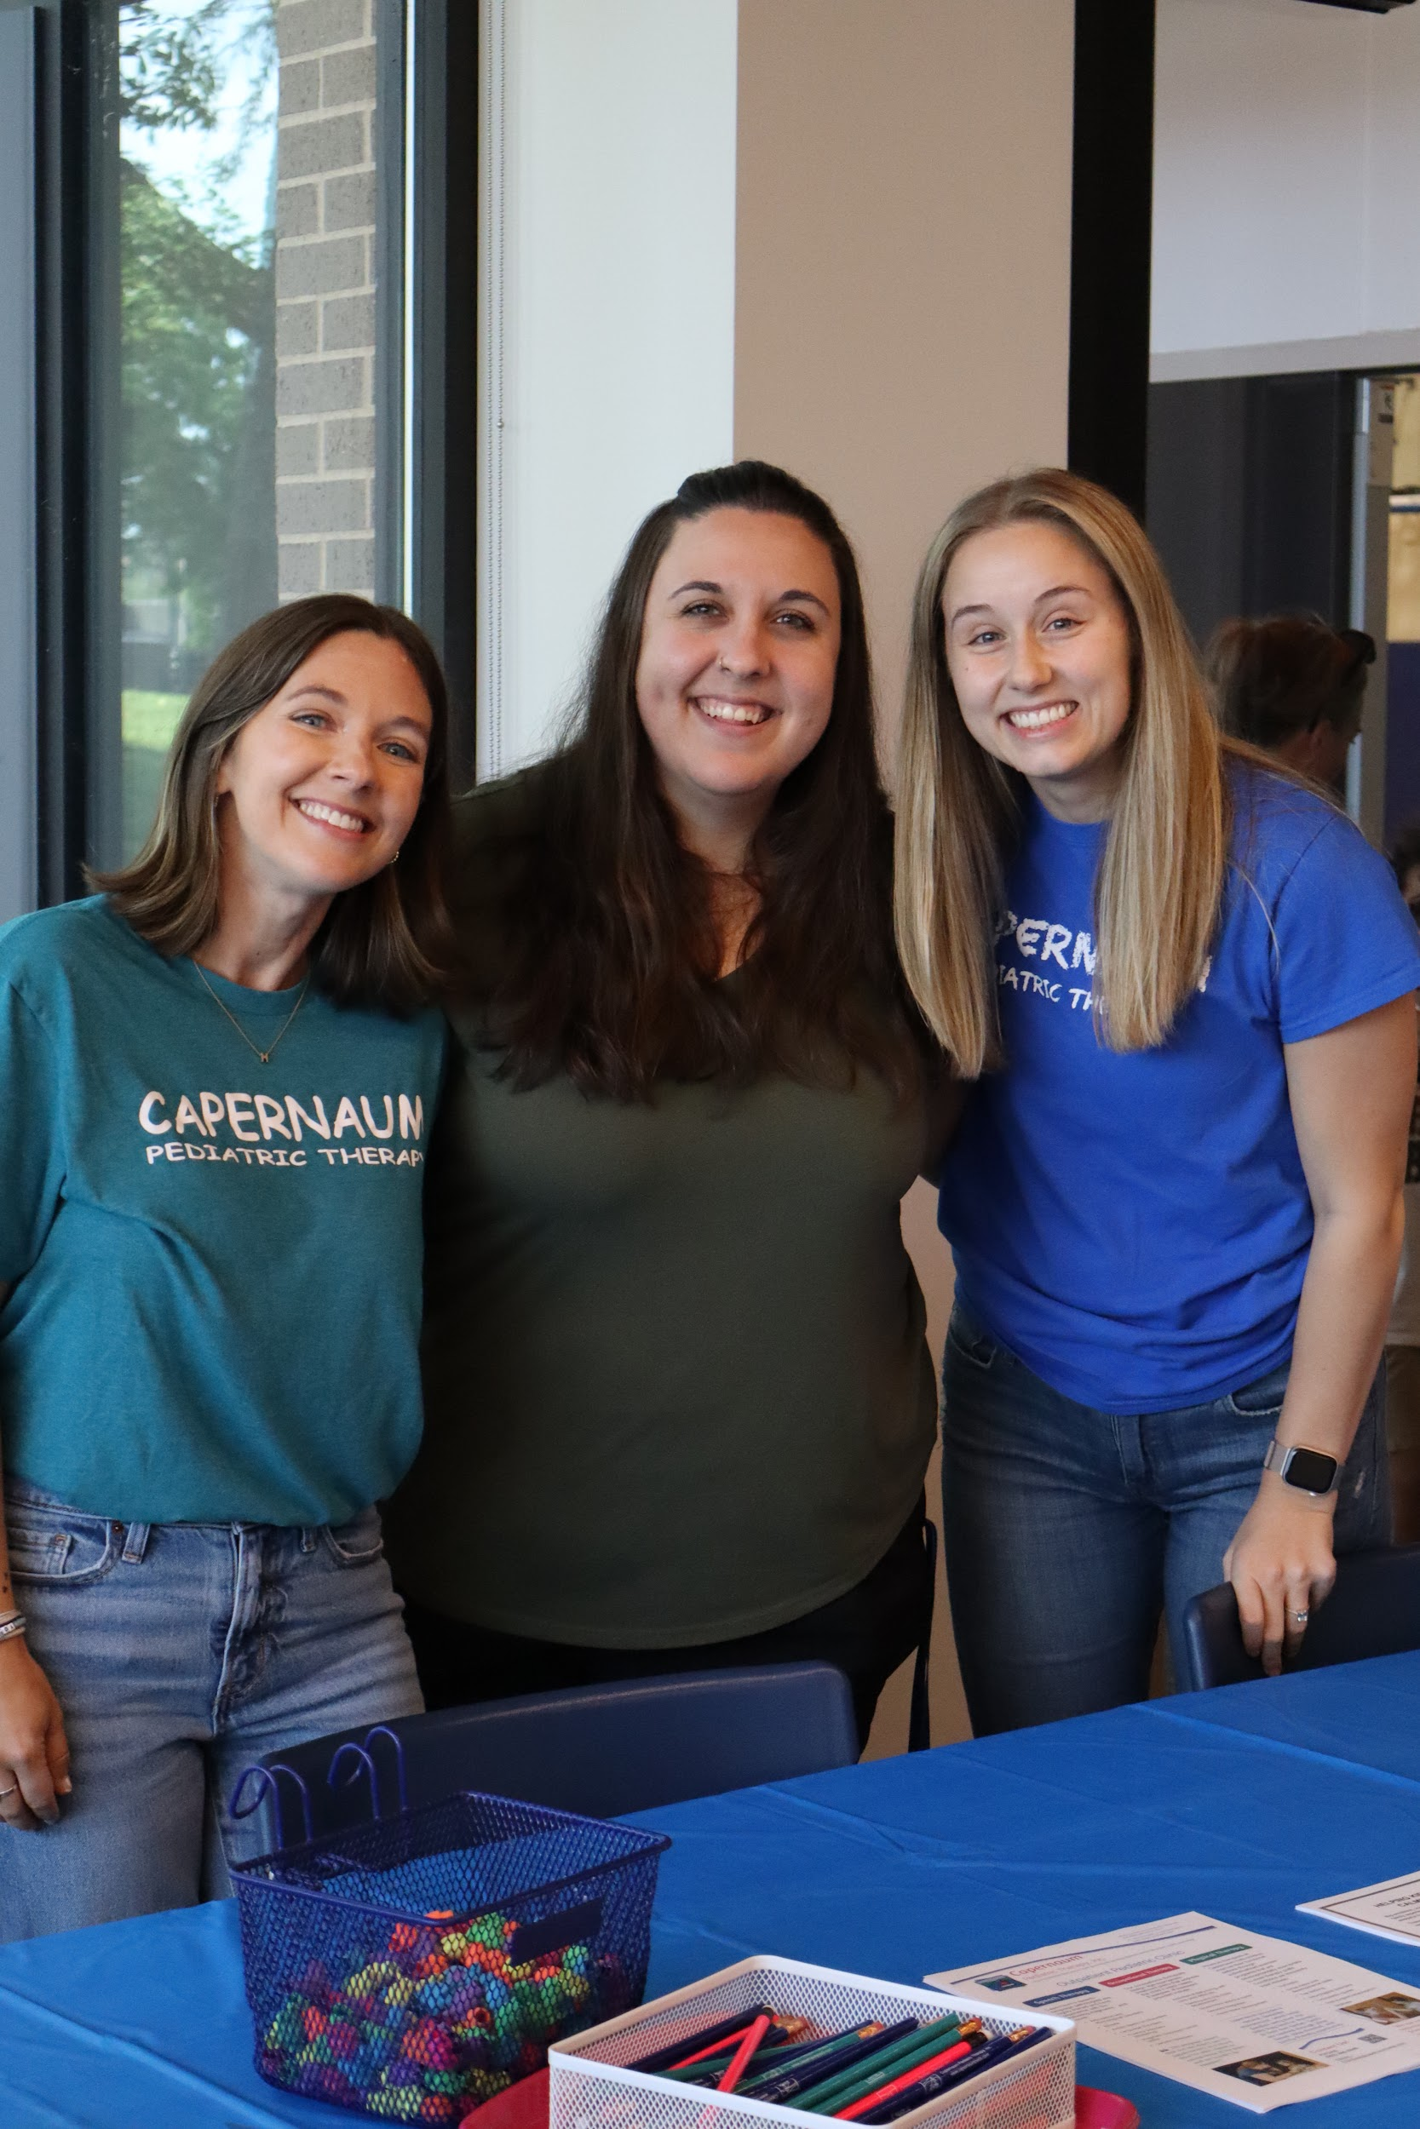
Capernaum Pediatrics
Capernaum Pediatric Therapy provides pediatric PT, OT, SLP, and feeding/nutrition services.
Therapists participate in services to ensure coordination of care
Regular collaboration meetings with the academy and therapy teams

Slide 38
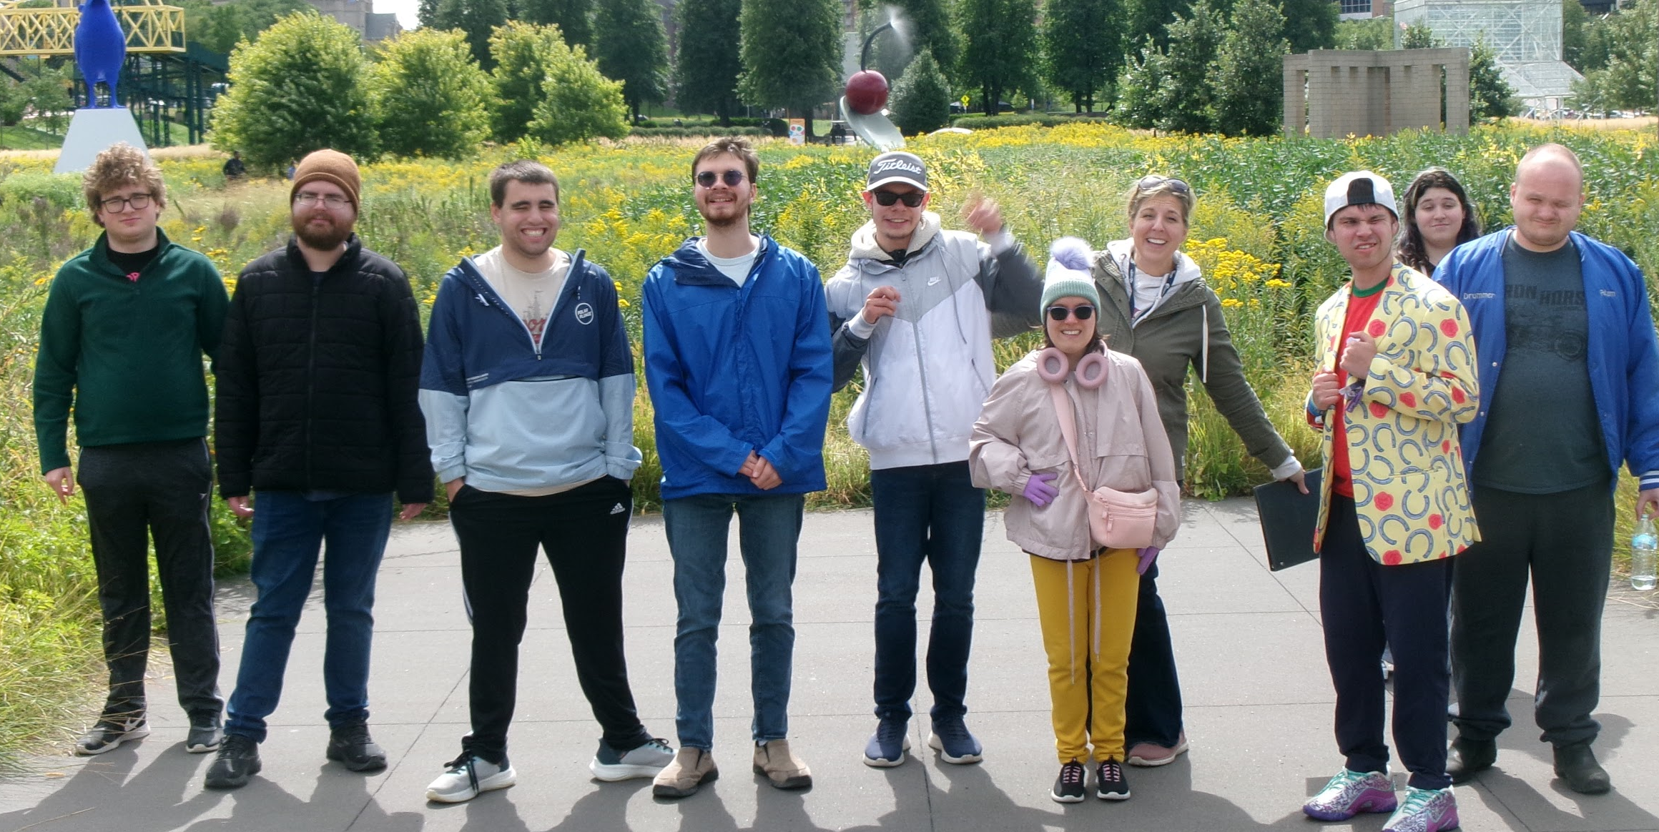
Mike Faeth
Capstone Director

Slide 39
Why Is This Needed?
POST SECONDARY EDUCATION
EMPLOYMENT
INDEPENDENT/SOCIAL LIVING
Only 38.8% with ASD who start college, finish college
~80% of students who received supports in HS do not receive them in college
  56% of those students said #1 reason was “they didn’t have a disability”
Only 10% of college graduates with ASD find work in their field of study
42% of those with ASD in early 20’s have ever been employed
By 25, still only 63%
Six years after leaving secondary school, only 20% work full-time (more than half for minimum wage or less)
More than 50% of those with ASD receive no services at all in their 20s.
25% report severe feelings of social isolation
Only 20%- by their mid-20s have lived independently.

Slide 40

Flexible/Full-Year Scheduling
We have three program tiers:
  Full-Day: (30 hrs a week-43 weeks)
    9:00am-4:30pm, M-Th
  Flex-Day: (20 hrs a week-43 weeks)
    9:00am-2:00pm, 10:00am-3:00pm, 11:00-4:00pm, M-Th
  College Flex: (8 hrs a week-43 weeks)
    2:30pm-6:30pm, Mondays and Wednesdays
Community Engagement Fridays (10am-3:30pm)
  All-Year (43 Fridays and 2 overnights)
  Half-Year (19 Fridays and 2 overnights)
    Both options attend one of our three-day overnight trips
We are never off for more than 2 weeks in a row

Slide 41
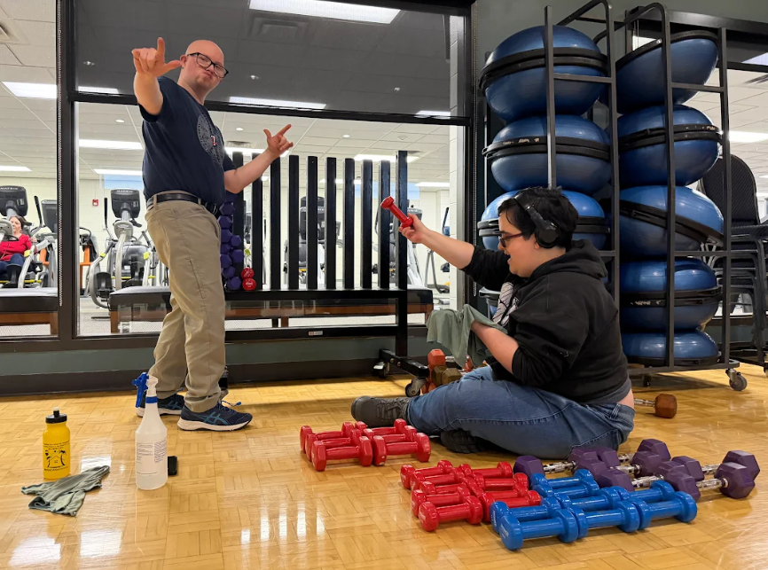
Voc-Rehab Community Partner
We provide Pre-ETS Services
  Career Exploration
  Post-Secondary Exploration
  Work-Based Learning
  Workplace Readiness Training
  Self-Advocacy
As well as additional General Services:
  Social Coaching
  Permit Prep
  Job Coaching

Slide 42
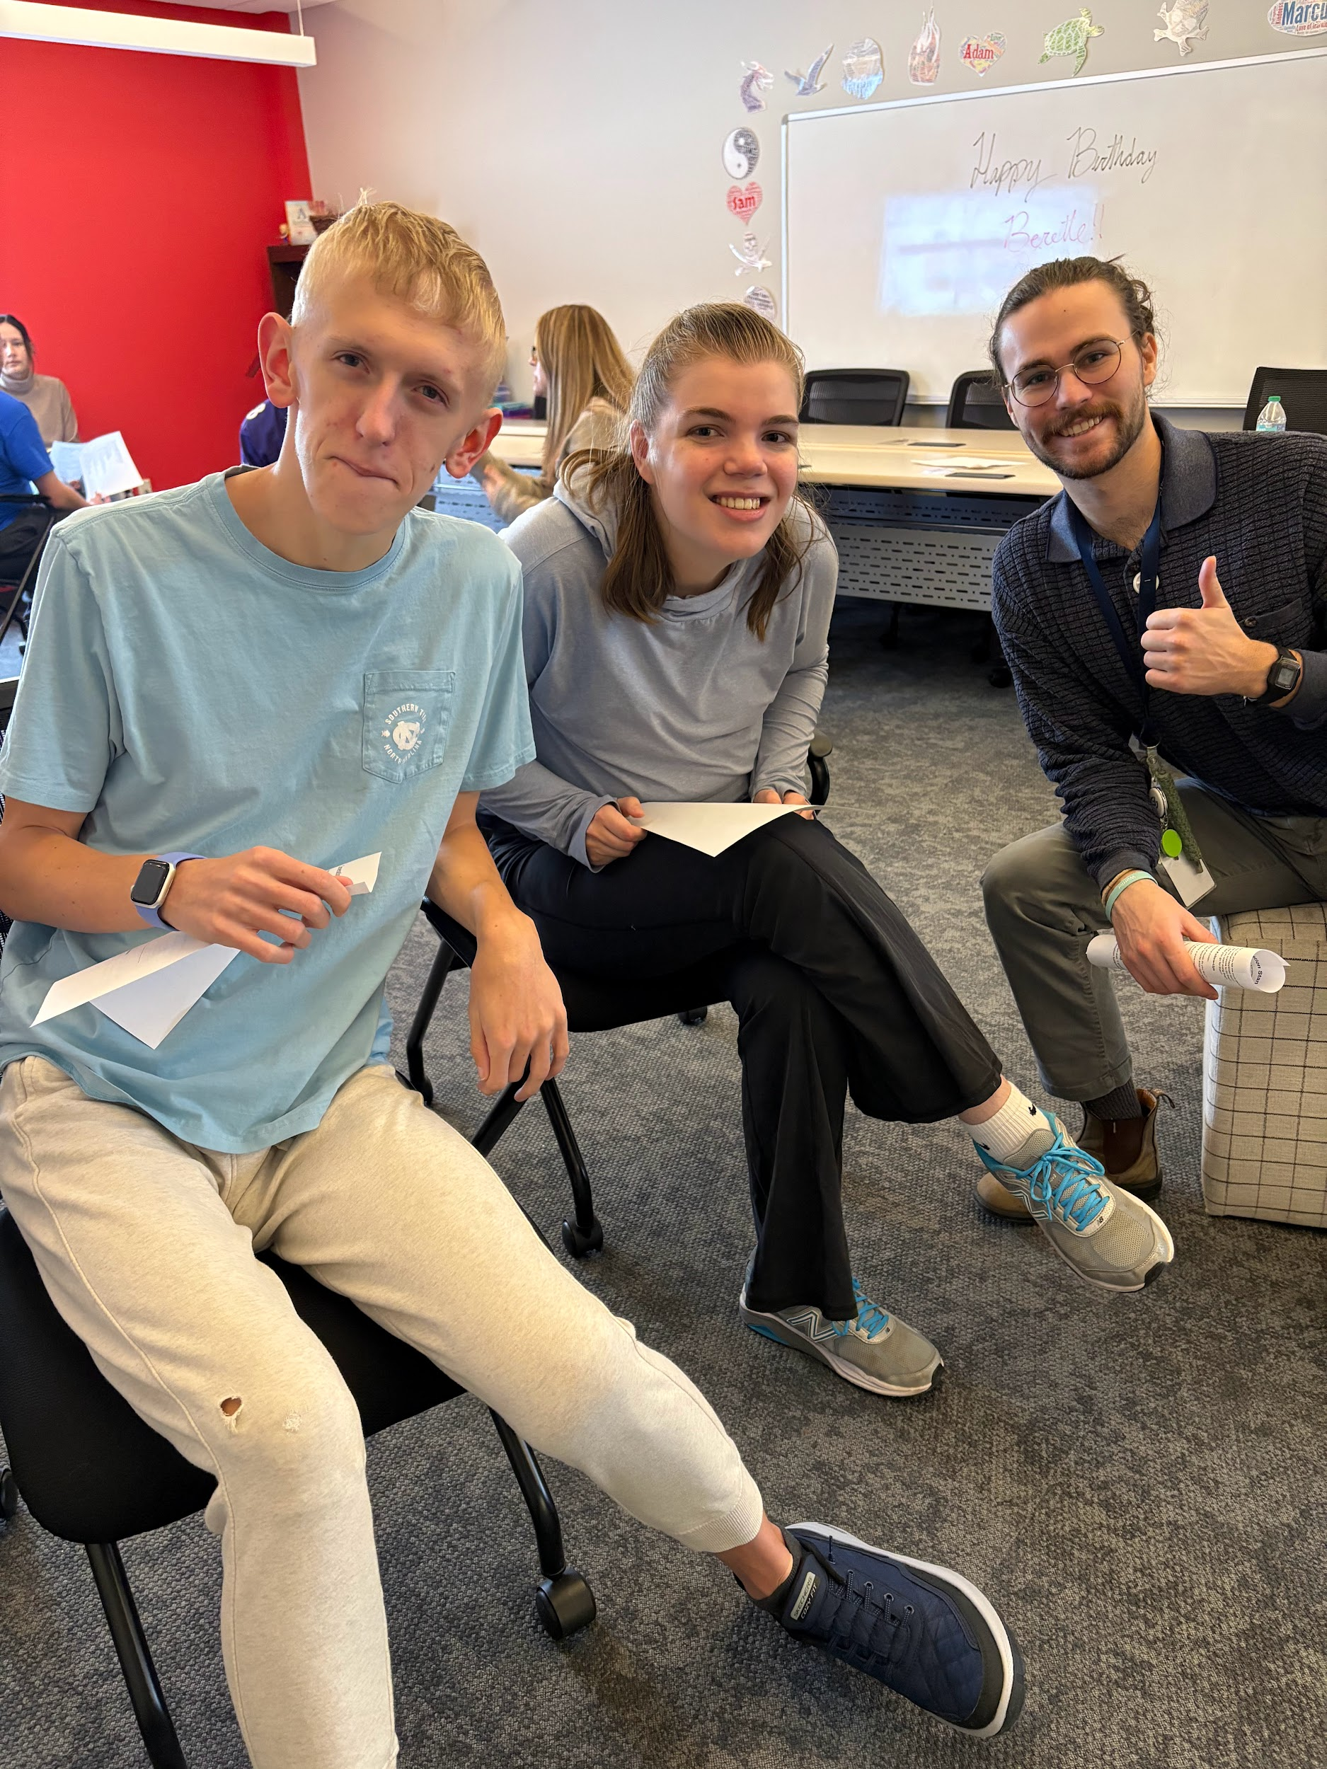
Student Accomplishments/Demographics
34 Current Participants
  Ages 18-28
  25 Full and Flex students
    ~50% are currently competitively employed
  6 College Flex
    83% are either college graduates or currently enrolled part-time in college
  3 Social Fridays (alumni)
  86% remain employed past 90-day eval period
  100% of those who do not work, volunteer
  88% have socialized with peers outside of programming in last year
16 are Franklin Academy graduates, 18 came externally
Male/Female ratio is similar to ASD ratio (3:1)

Slide 43
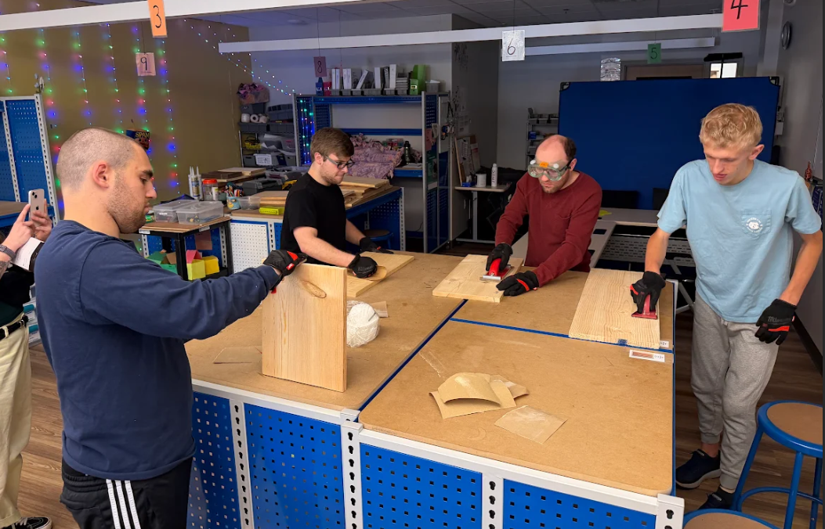
Admissions Criteria
Our Criteria for Admissions:
  Ages 18-28
  You have to want to be here and want to grow
    And we have to think we can help you
  No recent (2 years) history of physical or verbal aggression
  No recent (2 years) issues with elopement
  Independence with basic self-care and movement about community
  Relatively calm demeanor
  Foundational communication and literacy skills
We employ experienced and qualified staff
  Over 80% of staff either have Master’s Degree and/or SPED License
We have a student-staff ratio of no more than 9:1 and no less than 4:1
  Current exceptions for volunteering and cooking
Each student gets weekly 1:1 meeting-time with staff for goal setting, support, and follow-through

Slide 44
Capstone Parents
Exit to Community Room for Q&A

Slide 45
Academy Parent Testimonials

Slide 46
Questions?

